Slide 1
Employee Data Analysis using Excel
STUDENT NAME: B SULAMAN
REGISTER NO:422200736
DEPARTMENT: B COM(Information system management)
COLLEGE: SREE MUTHUKUMARA SWAMY COLLAGE

Slide 2
PROJECT TITLE
Employee Performance Analysis using Excel

Slide 3


AGENDA
Problem Statement
Project Overview
End Users
Our Solution and Proposition
Dataset Description
Modelling Approach
Results and Discussion
Conclusion
3/21/2024 Annual Review

Slide 4

PROBLEM STATEMENT
Utilize Excel to effciently analyse employee data by leveraging functions such as PivotTables, and conditional formatting.
This enables the identification of key trends, such as current employee rates, performance levels.
Decision-making processes by visualizing this data through pie chart.”

Slide 5

PROJECT OVERVIEW
This project focuses on analysing employee data to identify trends and insights that can drive better decisions.
Excel will be used to clean, organize, and visualize key metrics such as employee demographics, performance, and retention rates.
The analysis will highlight areas of improvement in workforce management, helping to optimize resource allocation.
Outcomes will include detailed reports and dashboards for management review.
The findings aim to support strategic planning.

Slide 6


WHO ARE THE END USERS?
The end users of the employee data analysis are HR managers, team leads, and senior management.

Slide 7

OUR SOLUTION AND ITS VALUE PROPOSITION
Conditional formatting – highlights missing cells
Filter- helps to remove the empty cells
Formula – helps to identify the performance of employees
Pivot table – helps to summarise
Pie chart – shows the data

Slide 8
Dataset Description
EMPLOYEE ID
FIRST NAME
LAST NAME
BUSINESS UNIT
EMPLOYEE TYPE
EMPLOYEE CLASSIFICATION TYPE
GENDER
PERFORMANCE SCORE
CURRENT EMPLOYEE RATE
PERFORMANCE LEVEL

Slide 9

THE "WOW" IN OUR SOLUTION
Performance level
=IFS(Z9>=5,”VERY HIGH”,Z9>=4,”HIGH”,Z9>=3,”MED”,TRUE,”LOW”)
3/21/2024 Annual Review
9

Slide 10
MODELLING
DATA COLLECTION
Standardization
Data analysis involves examining, transforming, and modeling data to extract meaningful insights, identify patterns, and support decision-making.
Correction
Validation
SUMMARY
Identification
Gathering
Preparation
DATA CLEANING
10

Slide 11
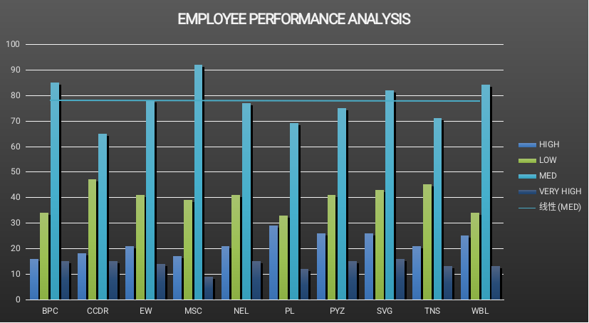
RESULTS
11

Slide 12

conclusion
In conclusion, the employee data analysis conducted using Excel provided valuable insights into workforce trends, enabling more informed decision-making.
The use of Excel allowed for efficient data organization, visualization, and reporting, ultimately helping to enhance HR strategies, improve employee satisfaction.

